Slide 1
Sprint 1: Dynamic Programming
STOR608 Contemporary Topic Sprints
Prof. Dong Li
d.li21@lancaster.ac.uk
Week 7 Michaelmas term

Slide 2

Prof. Dong Li
Professor of Operational Research
BEng/MEng Mechanical Engineering (XJTU, China); MEng Industrial Engineering (NUS, Singapore); PhD Management Science (Lancaster University, UK)
Working experience
Loughborough University – Senior lecturer, Reader in operations management
University of York – Lecturer in operations management
Intel Corporation, Avis Budget EMEA - Production planning and scheduling, Forecasting, Revenue Management
Main research interest
Revenue Management, Healthcare Operations Management
Stochastic modelling, Reinforcement Learning
Personal interests: Badminton, walking, cooking

Slide 3
About yourself
Name
Where from
Previous degrees (Undergraduate, postgraduate)

Slide 4
Agenda
A Working Example – Car Rental Booking Control
Markov Decision Process
Dynamic programming
Bellman Equation
Principle of Optimality
Curse of Dimensionality
Infinite Horizon Problems
Approximate Dynamic Programming
The Assignment
Reference

Slide 5
A Working Example – Car Rental Booking Control

Slide 6



A Working Example: Car Rental Booking Control
A car rental company has two cars:
1 large car, rental rate £40/day, 1 small car, rental rate £30/day
Booking Process:
Exclusively 1-day rentals, must booked the day before.
Bookings arrive randomly in two batches (Morning, Afternoon) of previous day
Each batch has one of the four possible demand (# Large requests, # Small requests)
Demand Forecast
(# Large requests, # Small Requests) | (0,0) | (0,1) | (1,0) | (1,1)
Arrival Probability | 3% | 10% | 20% | 67%
Morning Batch
Afternoon Batch
Rental Day
Notes:
Two resources: full-size and compact car.

Slide 7
A Working Example: Car Rental Booking Control
Morning Batch
Afternoon Batch
Rental Day
Booking Controls:
Accept a booking request,
Reject a booking request,
Upgrade: Small size demand can be met by the large car offered at £30
Goal: Find a booking control policy that maximises the firm’s expected revenues
Notes:
Two resources: full-size and compact car.

Slide 8
Features of this Problem
A sequential (multi-stage) decision-making problem
Morning decision impacts the course of the afternoon
Random disturbance
Demand arrives randomly over time
Dynamic system
The number of available cars changes with the demand and action
Other examples
Hotel room booking control/pricing
Multi-period inventory control/news-vendor problem
Production scheduling
Triage at A&E/clinical trials
Machine maintenance
And many more…
Airline booking control/pricing
Resource allocation
Search and patrol
Notes:
Two resources: full-size and compact car.

Slide 9
Markov decision process

Slide 10
Markov Decision Process
Such problems can often be modelled as a Markov Decision Process (MDP):
Optimal control of a system over a finite/infinite time horizon (stages)
System is dynamic (i.e. changes over time) and is characterised by a state, which is a singular or multiple information variables that characterise how the system progresses
State dynamics (transition) is a function of control decisions (actions) and random disturbances
System generates rewards after each decision is made
Objective: find a policy (a sequence of control decisions) that maximises the overall expected rewards
Notes:
Ask student: how does it work for infinite horizon problems?

Slide 11
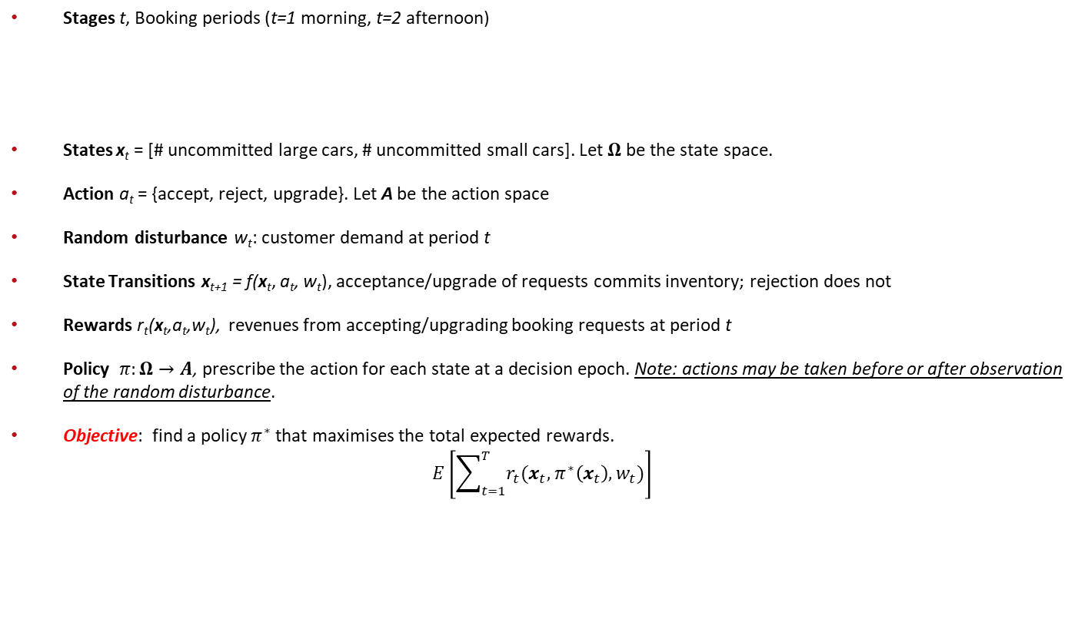
MDP for the Car Rental Example
Stages t, Booking periods (t=1 morning, t=2 afternoon)
States x_{t} = [# uncommitted large cars, # uncommitted small cars]. Let $Ω$ be the state space.
Action a_{t} = {accept, reject, upgrade}. Let A be the action space
Random disturbance w_{t}: customer demand at period t
State Transitions x_{t+1} = f(x_{t}, a_{t}, w_{t}), acceptance/upgrade of requests commits inventory; rejection does not
Rewards r_{t}(x_{t},a_{t},w_{t}), revenues from accepting/upgrading booking requests at period t
Policy $π:Ω→A$, prescribe the action for each state at a decision epoch. Note: actions may be taken before or after observation of the random disturbance.
Objective: find a policy $π^{∗}$that maximises the total expected rewards.
$$E\left[\sum_{t=1}^{T}{r_{t}(x_{t}, π^{∗}\left(x_{t}\right),w_{t}})\right]$$
Morning Batch
Afternoon Batch
Rental Day
t=1
t=2
t=3=T
Notes:
stochastic DP: demand unknown

Slide 12
Dynamic programming

Slide 13
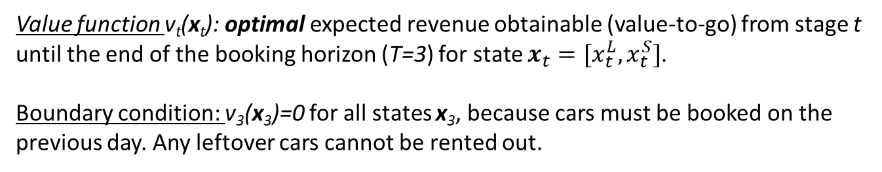
Dynamic Programming
To solve it, the problem is formulated into a Dynamic Program. Firstly Define
Value function v_{t}(x_{t}): optimal expected revenue obtainable (value-to-go) from stage t until the end of the booking horizon (T=3) for state $x_{t}=[{x_{t}^{L},x}_{t}^{S}]$.
Boundary condition: v₃(x₃)=0 for all states x₃, because cars must be booked on the previous day. Any leftover cars cannot be rented out.
Morning Batch
Afternoon Batch
Rental Day
t=1
t=2
t=3=T
v₁(x₁):
v₂(x₂):
v₃(x₃):

Slide 14


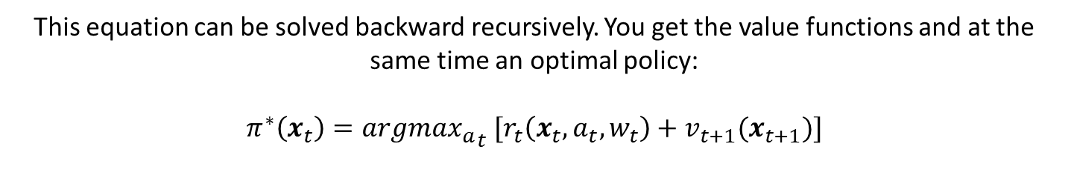
Bellman Equation
$v_{t}\left(x_{t}\right)=E\left[\max_{a_{t}∈A }\left\{r_{t}\left(x_{t}, a_{t},w_{t}\right)+v_{t+1}(x_{t+1})\right\}\right], ∀x_{t}∈Ω, t=1,2$
Immediate reward from action future reward
$$v_{3}\left(x_{3}\right)=0, ∀x_{3}∈Ω$$
This equation can be solved backward recursively. You get the value functions and at the same time an optimal policy:
$$π^{∗}\left(x_{t}\right)=argma{x_{a}}_{t} [r_{t}\left(x_{t}, a_{t},w_{t}\right)+v_{t+1}(x_{t+1})]$$
Note: $E\left[\max\left\{.\right\}\right] or\max{E[.]}?$
Notes:
NOTE: in traditional dynamic programming, often max E[.] instead of E[max{.}] is used.
Both form can be shown to be equivalent (see footnote in T&vR p.37), but E[max{.}] is easier to work with because of the reduced state space!
Equivalence can be shown by expanding the state space to include demand. In RM, we often observe the disturbance and decide afterwards. If the decision depends on expectation, max E[.] should be used.

Slide 15
Principle of Optimality
The solution of such a procedure is guaranteed to be optimal when the problem satisfies the so-called Principle of Optimality.
Define a tail sub-problem at stage t as a truncated version of the original problem starting from stage t.
Principle of Optimality: Whatever the initial state is, the remaining decisions in an optimal policy from any stage must be optimal with regard the tail sub-problem at that stage.
$$x_{0}$$
$$x_{t}$$
tail sub-problem
1
t
T
$π^{∗}(x_{0})$ …… $π^{∗}(x_{t})$ ……$π^{∗}(x_{T})$

Slide 16

Value Function for a Given Policy
Bellman Equation
$$v_{t}\left(x_{t}\right)=E\left[\max_{a_{t}∈A }\left\{r_{t}\left(x_{t}, a_{t},w_{t}\right)+v_{t+1}(x_{t+1})\right\}\right]$$
For a given policy $π$
$$v_{t}^{π}\left(x_{t}\right)=E\left[r_{t}\left(x_{t}, {π(x}_{t}),w_{t}\right)+v_{t+1}^{π}(x_{t+1})\right]$$

Slide 17
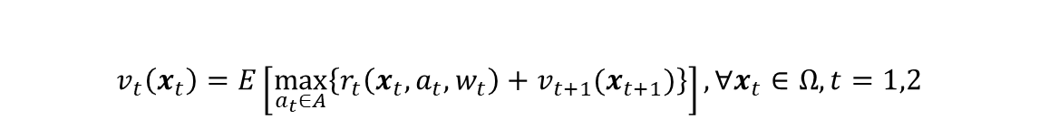
Curse of Dimensionality
$v_{t}\left(x_{t}\right)=E\left[\max_{a_{t}∈A}\left\{r_{t}\left(x_{t}, a_{t},w_{t}\right)+v_{t+1}(x_{t+1})\right\}\right], ∀x_{t}∈Ω, t=1,2$
State space
Action space
Calculation of the expectation
Question: Suppose there are M car types, each has C number of cars. What is the state space size in the car rental problem?
!! Bellman equation can only be solved for very small instances. !!
Notes:
(C+1)^M

Slide 18
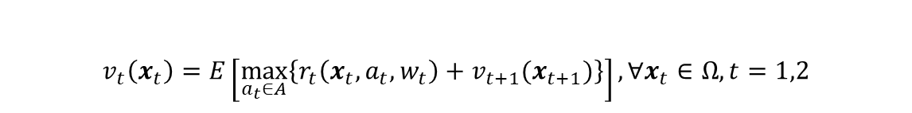
Exercise: Solve the Car Rental Problem
Demand Forecast
(# Large requests, # Small Requests) | (0,0) | (0,1) | (1,0) | (1,1)
Arrival Probability | 3% | 10% | 20% | 67%
$v_{t}\left(x_{t}\right)=E\left[\max_{a_{t}∈A}\left\{r_{t}\left(x_{t}, a_{t},w_{t}\right)+v_{t+1}(x_{t+1})\right\}\right], ∀x_{t}∈Ω, t=1,2$
Morning Batch
Afternoon Batch
Rental Day

Slide 19
Let us Make it More Realistic
Cars can be rented for more than one days
More granular booking periods, say every hour, or every 15mins
More types of cars
Larger fleet
A network of rental stations
Advanced booking

Slide 20
Infinite horizon Dynamic program

Slide 21

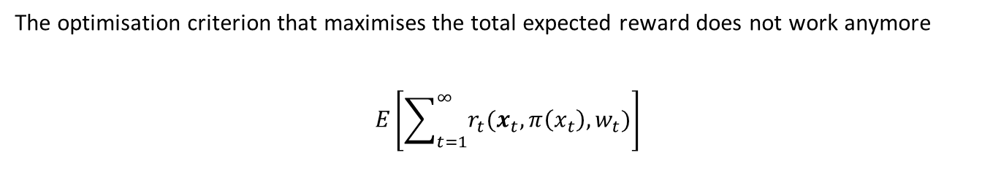


From Finite to Infinite Time Horizon
The optimisation criterion that maximises the total expected reward does not work anymore
$$E\left[\sum_{t=1}^{∞}{r_{t}(x_{t}, π\left(x_{t}\right),w_{t}})\right]$$
$$E\left[\sum_{t=1}^{∞}{{β^{t}r}_{t}(x_{t}, π\left(x_{t}\right),w_{t}})\right]$$
1. Total discounted reward, $0<β<1$
2. Long run average reward
$$\lim_{T→∞}{\frac{1}{T}}E\left[\sum_{t=1}^{T}{r_{t}(x_{t}, π\left(x_{t}\right),w_{t}})\right]$$

Slide 22
Bellman Equation for Discounted Problems
There is no more a boundary condition. How to solve it?
$$v\left(x\right)=E\left[\max_{a∈A }\left\{r\left(x, a,w\right)+βv(f\left(x, a,w\right))\right\}\right],∀x∈Ω$$
Value iteration
Start from an (arbitrary) initial value for the value function at each state
Update iteratively using the Bellman equation
Policy Iteration
Start from a simple policy
Evaluate its value function
Improve the policy by Bellman Equation iteratively until no further improvement can be achieved
Linear programming
Terminate when the successive differences are small enough.
The Bellman equation for long run average reward is more involved. Refer to the seminal book by Puterman (2014)

Slide 23
Approximate dynamic programming

Slide 24
The Key Ideas
Approximate value functions
Replace $v_{t}\left(x_{t}\right)$ by an approximation ${\tilde{v}}_{t}\left(x_{t}\right)$
Replace 𝑣_𝑡 (𝒙_𝑡 ) by an approximation 𝑣 ̃_𝑡 (𝒙_𝑡 )
Then a control policy can be obtained by
$$π\left(x_{t}\right)=argma{x_{a}}_{t} \left[r_{t}\left(x_{t}, a_{t},w_{t}\right)+{\tilde{v}}_{t+1}\left(x_{t+1}\right)\right]$$
𝜋(𝒙_𝑡 )=𝑎𝑟𝑔𝑚𝑎〖𝑥_𝑎〗_𝑡 [𝑟_𝑡 (𝒙_𝑡, 𝑎_𝑡,𝑤_𝑡 )+𝑣 ̃_(𝑡+1) (𝒙_(𝑡+1) )]
The BIG question is: how to find good approximation ${\tilde{v}}_{t}\left(⋅\right)$ efficiently ??
The BIG question is: how to find good approximation 𝑣 ̃_𝑡 (⋅) efficiently ??
Notes:
The second step here is just one-step lookahead. We can also use multiple look ahead to further improve the policy.
For multiple look ahead, it can be solved by a dynamic program (for small and simpler problems) or by simulation. For the latter, MCTS is used to quickly prune those inferior actions.

Slide 25
A Wide Range of ADP Methods
Parametric value function approximation
$\tilde{v}\left(x\right)=\sum_{i=1}^{I}{r_{i}φ_{i}(x)}$, where $φ_{i}\left(x\right)$ are called basis/feature functions
𝑣 ̃(𝒙)=∑_(𝑖=1)^𝐼▒〖𝑟_𝑖 𝜙_𝑖 (𝒙)〗, where 𝜙_𝑖 (𝒙) are called basis/feature functions
The dimension of the weights ${r=\{r}_{1},r_{2},⋯, r_{I}\}$ is significantly less than the state dimensionality
The dimension of the weights 〖𝑟={𝑟〗_1,𝑟_2,⋯, 𝑟_𝐼} is significantly less than the state dimensionality
Regression can be used to find the best r values.
A challenge is to find the appropriate structure of the basis functions.
Neural networks
Problem approximation
Deterministic approximation
Decomposition- Lagrangian relaxation
State aggregation
Automatically construct the basis functions.
Rollout
Use the value function of a simple heuristic
Evaluated either analytically (only for small or special problems) or more commonly by (Monte Carlo) simulation
Notes:
The training data is generated from the bellman equation and the previous estimated value function. Also the optimal action is obtained based on Bellman equation. So it requires a model, i.e., the transition probabilities and reward functions.
Q-learning instead uses simulation to generate the training data based on station and action pair.
Rollout can use certainty equivalence approximation to reduce simulation complexity

Slide 26
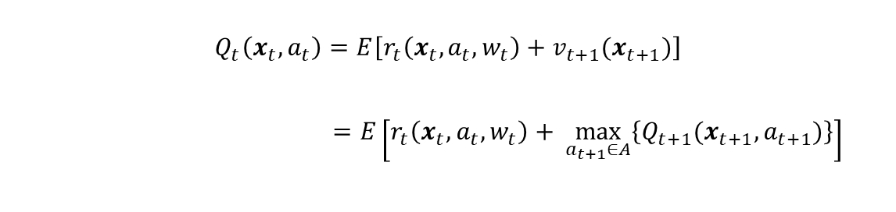
A Model Free Approach: Q-learning
Define the Q-factor $Q\left(x,a\right)$ as below
$$Q_{t}\left(x_{t},a_{t}\right)=E\left[r_{t}\left(x_{t}, a_{t},w_{t}\right)+v_{t+1}(x_{t+1})\right]$$
$$=E\left[r_{t}\left(x_{t}, a_{t},w_{t}\right)+ \max_{a_{t+1}∈A}\left\{Q_{t+1}(x_{t+1},a_{t+1})\right\}\right]$$
The Q-factor $Q\left(x,a\right)$ can be approximated iteratively using Monte Carlo simulation.
$$Q_{t}\left(x_{t},a_{t}\right)←Q_{t}\left(x_{t},a_{t}\right)+α[r_{t+1}+\max_{a_{t+1}∈A}{Q_{t+1}\left(x_{t+1},a_{t+1}\right)−Q_{t}\left(x_{t},a_{t}\right)]}$$
where $α∈(0,1)$ is the step size.
Notes:
The training data is generated from the bellman equation and the previous estimated value function. Also the optimal action is obtained based on Bellman equation. So it requires a model, i.e., the transition probabilities and reward functions.
Q-learning instead uses simulation to generate the training data based on station and action pair.

Slide 27
The assignment

Slide 28
Airline Booking Control Problem
An airline booking control problem
Model the problem into an MDP
Formulate the problem into a dynamic program, and write down the Bellman equation
Solve it using backward induction
Explore the structure of the value function and the optimal policy
Find an ADP approach to the problem and develop a heuristic policy, implement it and evaluate its performance using Bellman equation
How does it compare against the optimal solution? How does its computational time compare? What is your conclusion on its overall performance?

Slide 29
Drop in Sessions
Nov 18: 2-3:30pm
Nov 19: 2-3:30pm
Nov 20: 3-4:30pm
Nov 21: 9:30-10am
My office: Charles Carter D35

Slide 30
References
Talluri, K.T. and Van Ryzin, G.J., 2006. The theory and practice of revenue management (Vol. 68). Springer Science & Business Media.
Klein, R., Koch, S., Steinhardt, C. and Strauss, A.K., 2020. A review of revenue management: Recent generalizations and advances in industry applications. European journal of operational research, 284(2), pp.397-412.
Bondoux, N., Nguyen, A.Q., Fiig, T. and Acuna-Agost, R., 2020. Reinforcement learning applied to airline revenue management. Journal of Revenue and Pricing Management, 19(5), pp.332-348.
Li, D. and Pang, Z., 2017. Dynamic booking control for car rental revenue management: A decomposition approach. European Journal of Operational Research, 256(3), pp.850-867.
Puterman, M.L., 2014. Markov decision processes: discrete stochastic dynamic programming. John Wiley & Sons.

Slide 31
Thank you for your attention!
Dong Li
d.li21@lancaster.ac.uk

